Slide 1



AI- driven learning using KnowBot
Darker Grotesque
“Right
to
Right Knowledge”
Vijay K G (2022115063)
Jothiruban M (2022115096)
Deepak Chandhru N (2022115112)
Under the Guidance of
Dr K Vani , Professor
Academic Session August 2024 - December 2024

Slide 2

PROBLEM STATEMENT
In today's fast-paced world, learners often struggle with fragmented information and inconsistent study habits, leading to inefficient knowledge acquisition.
Although multiple learning resources such as PDFs, images, and videos are available online, managing and synthesizing these resources effectively is challenging.
Furthermore, learners may encounter doubts or unclear concepts, for which immediate clarification isn't always accessible. As a result, students lack a streamlined way to learn step-by-step, stay on track with consistent progress, and receive personalized support across multiple formats.

Slide 3

OUR OBJECTIVE
The Knowbot project aims to address these challenges by creating a platform where users can subscribe to any number of learning topics and receive daily personalized feeds with step-by-step learning modules.
Users will engage in quizzes to assess their understanding and can interact with an AI for real-time doubt clarification.
Knowbot also allows users to upload external resources, such as PDFs, images, and YouTube links, and engage with the AI to gain insights into the content.
This will help learners synthesize knowledge from diverse resources, maintain consistent learning habits, and receive personalized assistance.

Slide 4
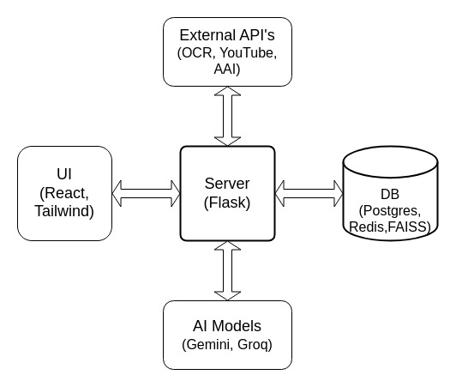
HIGH LEVEL SYSTEM ARCHITECTURE

Slide 5
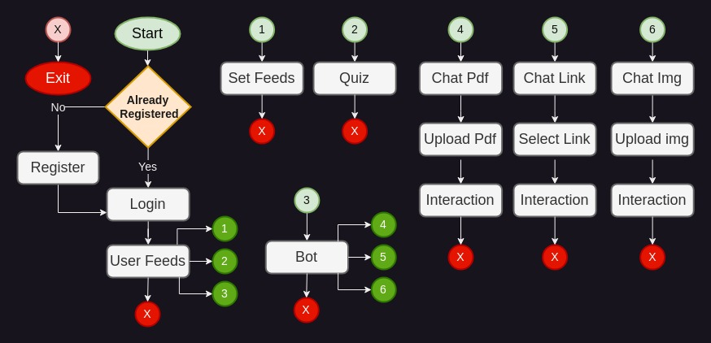
USER FLOW DIAGRAM

Slide 6
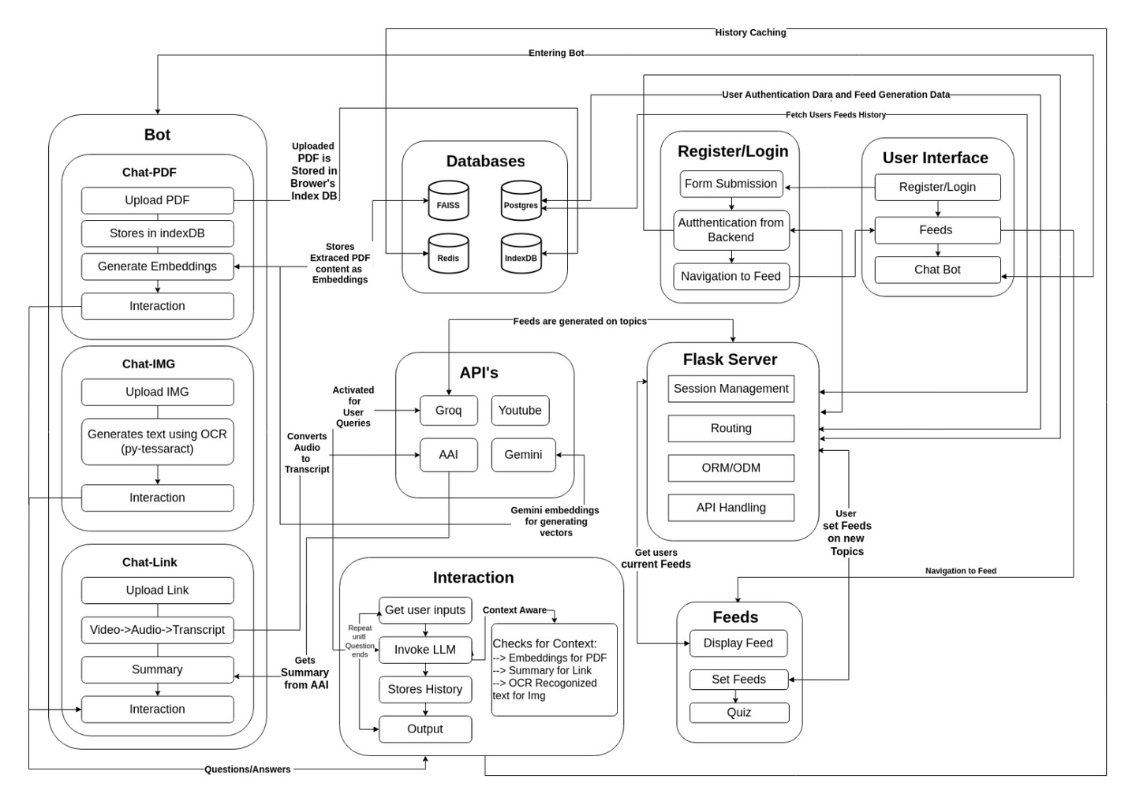
SYSTEM ARCHITECTURE

Slide 7
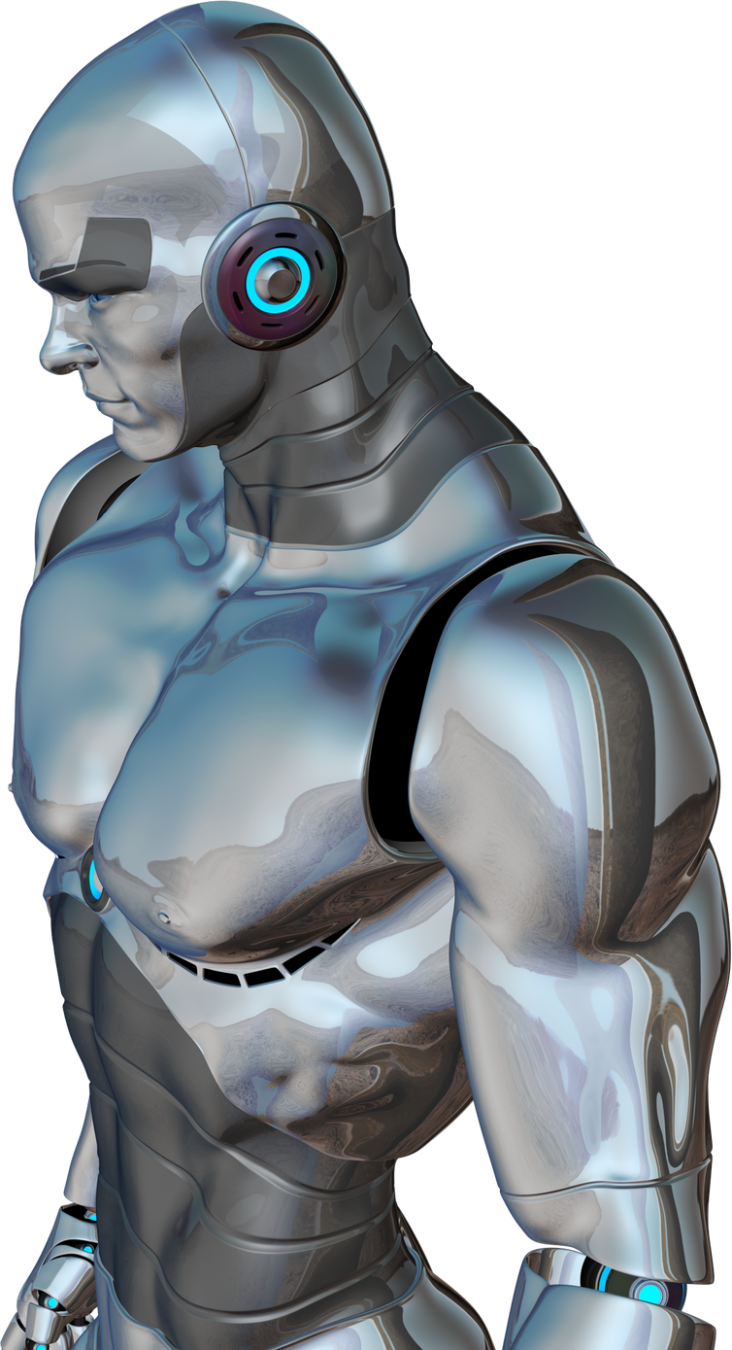







TECH STACK
BACKEND
FRONTEND
DATABASE
FLASK
REACT JS
POSTGRESQL
TAILWIND CSS
REDIS
APIS
YOUTUBE
GROQ
ASSEMBLY AI

Slide 8
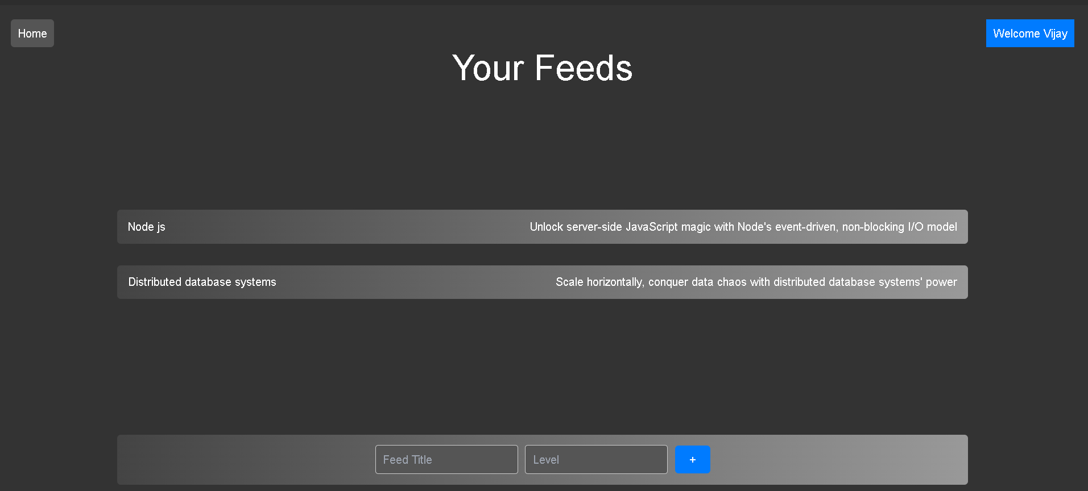
OUTPUT IMAGES

Slide 9
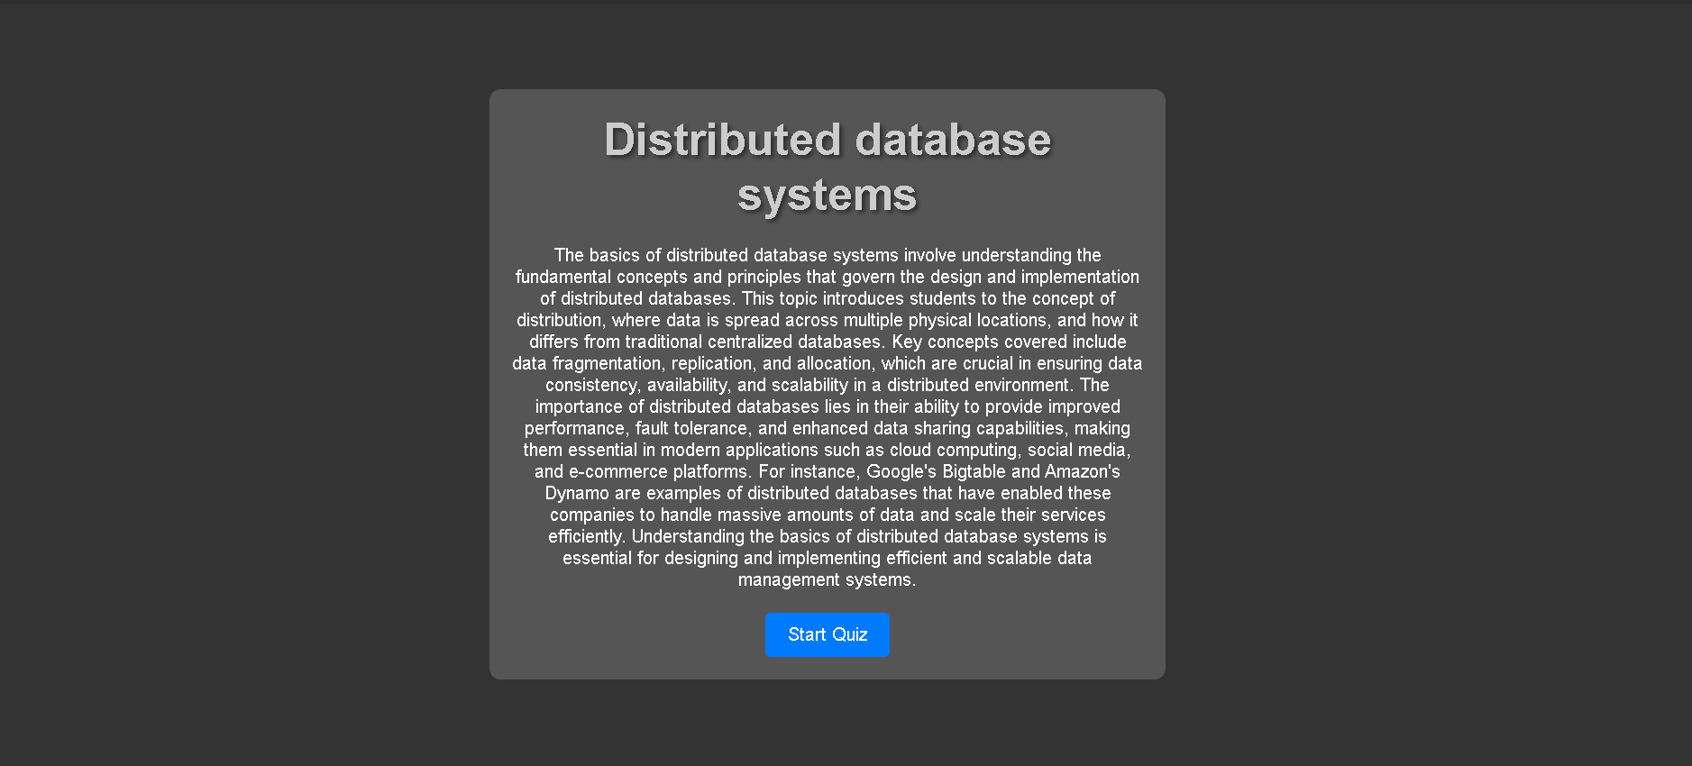
OUTPUT IMAGES

Slide 10
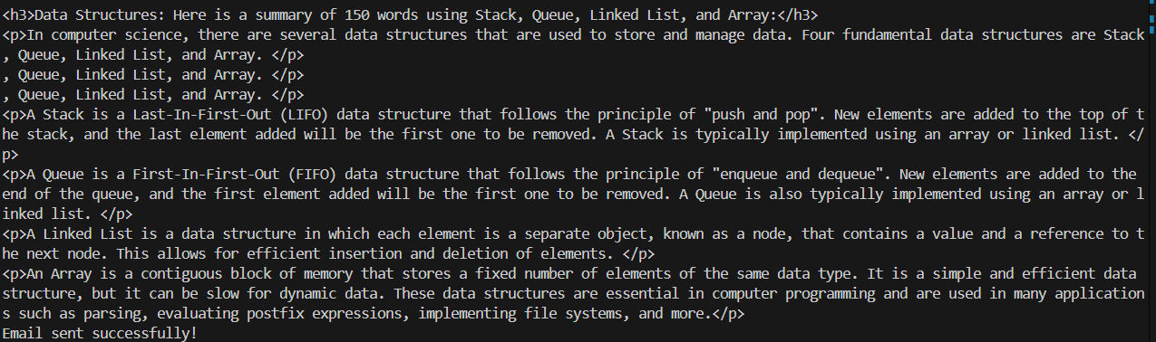
OUTPUT IMAGES

Slide 11
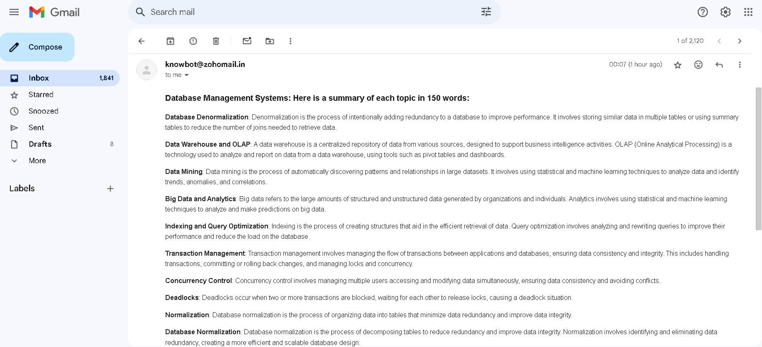
OUTPUT IMAGES

Slide 12
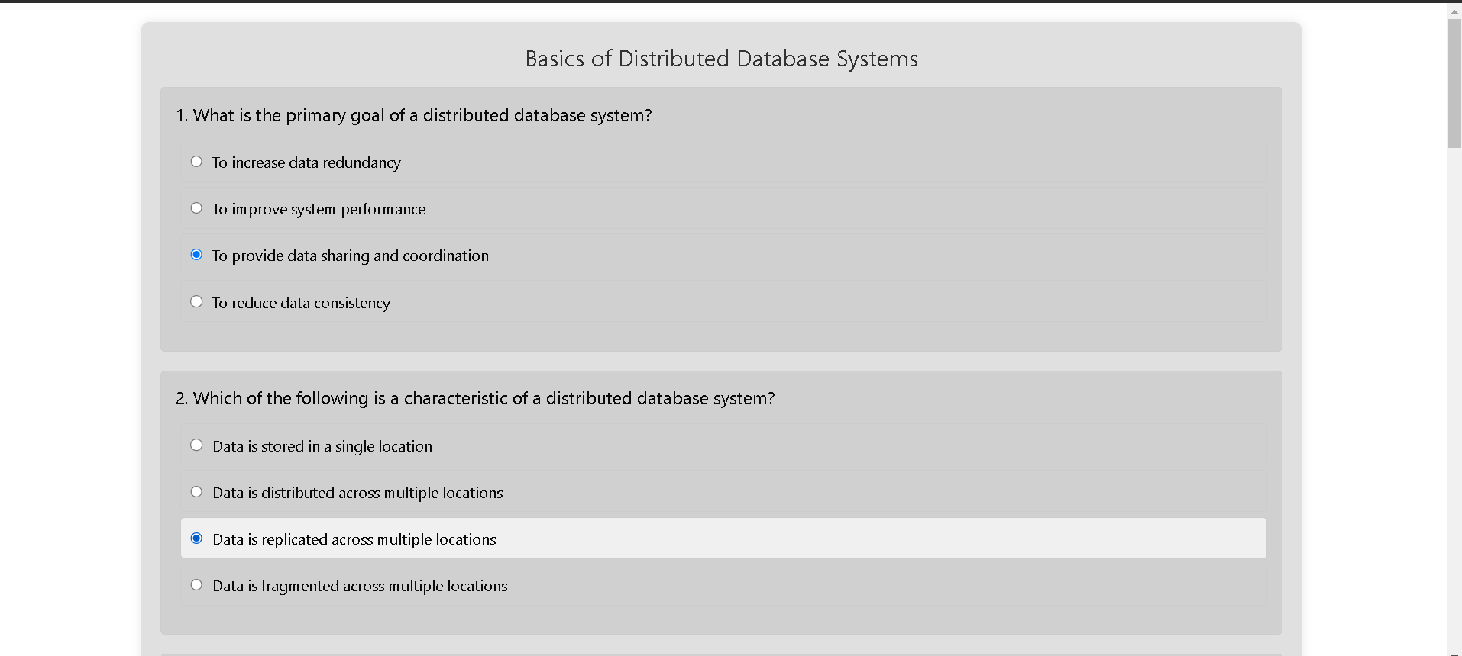
OUTPUT IMAGES

Slide 13
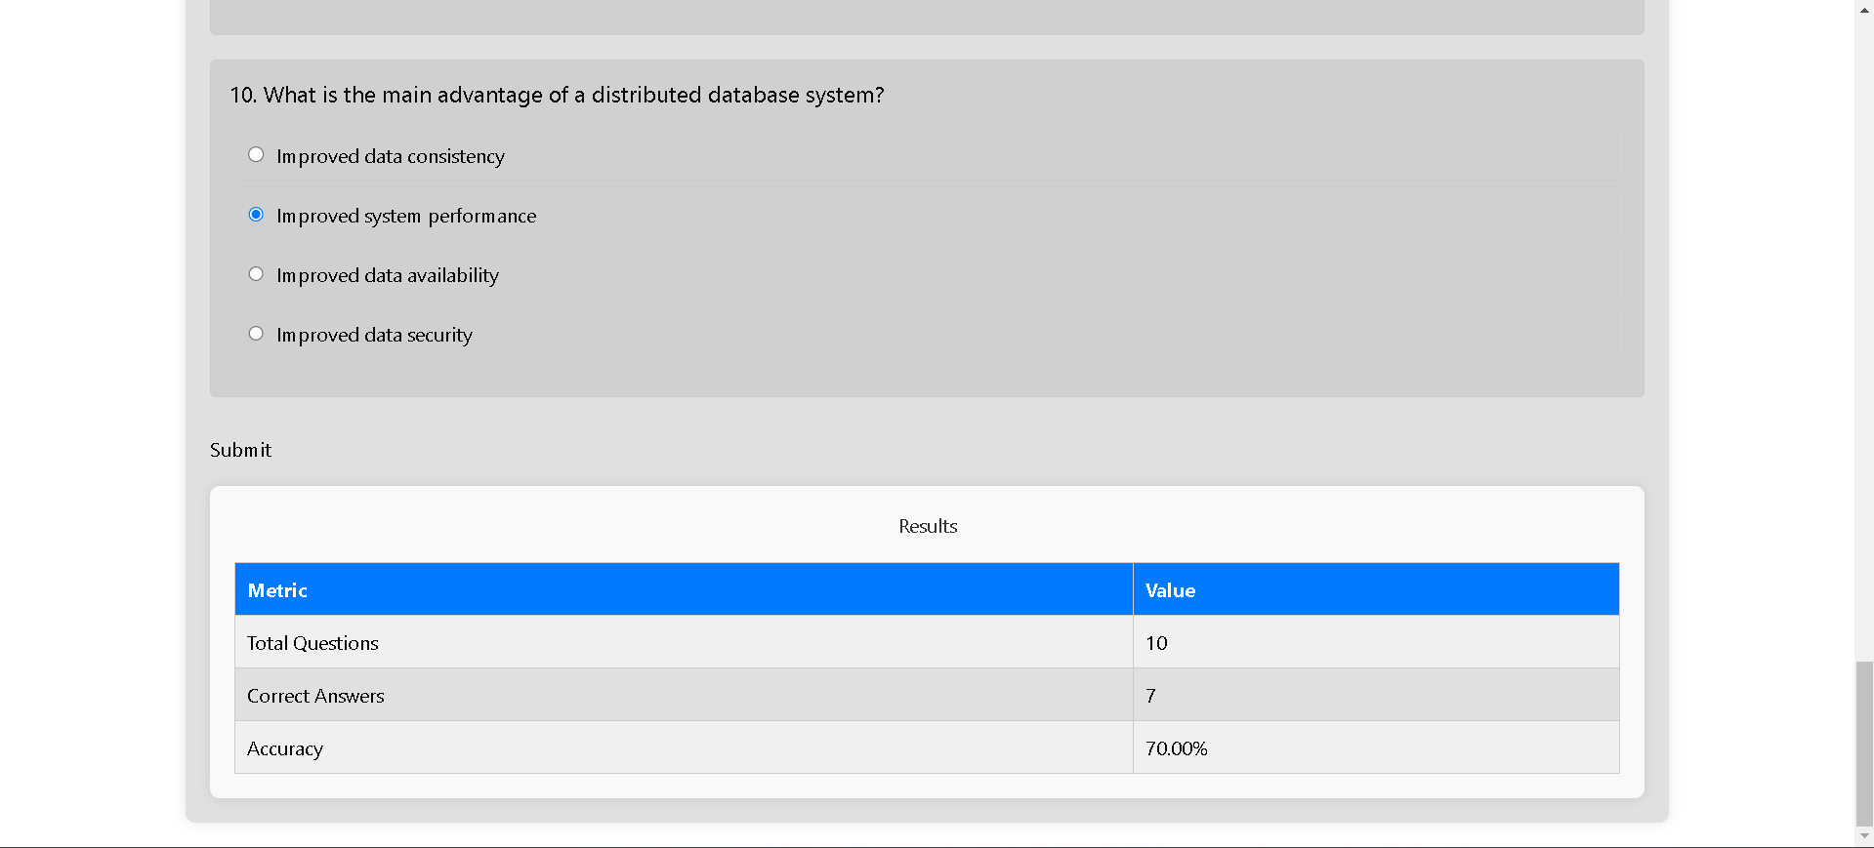
OUTPUT IMAGES

Slide 14
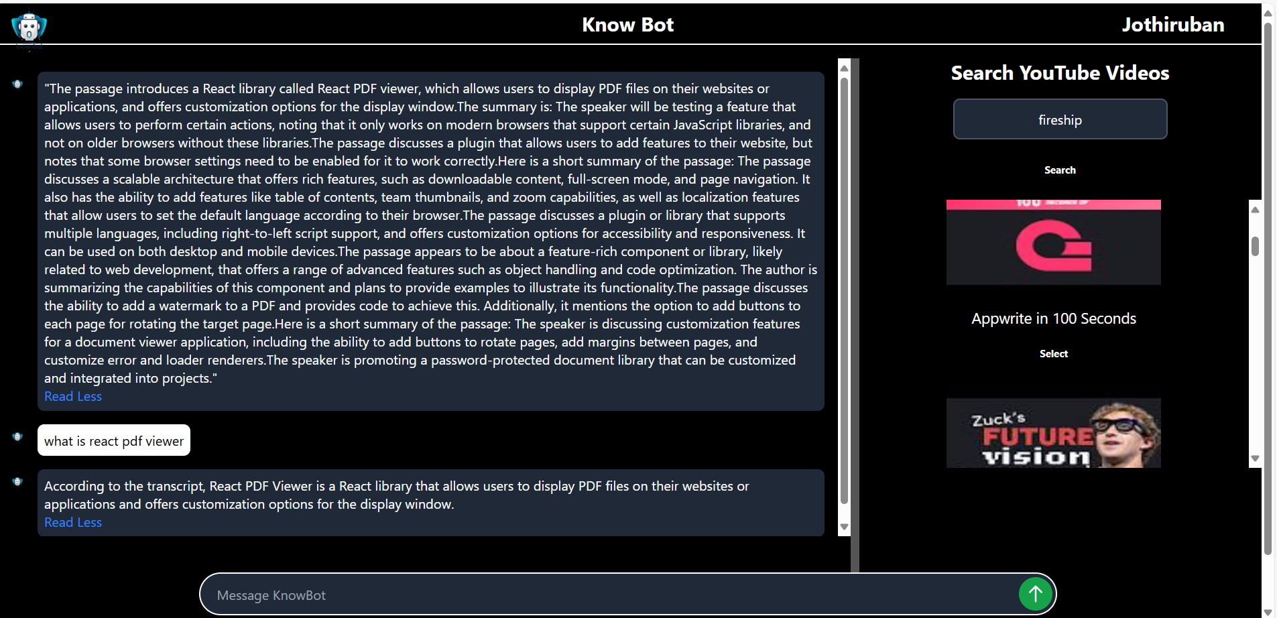
OUTPUT IMAGES

Slide 15
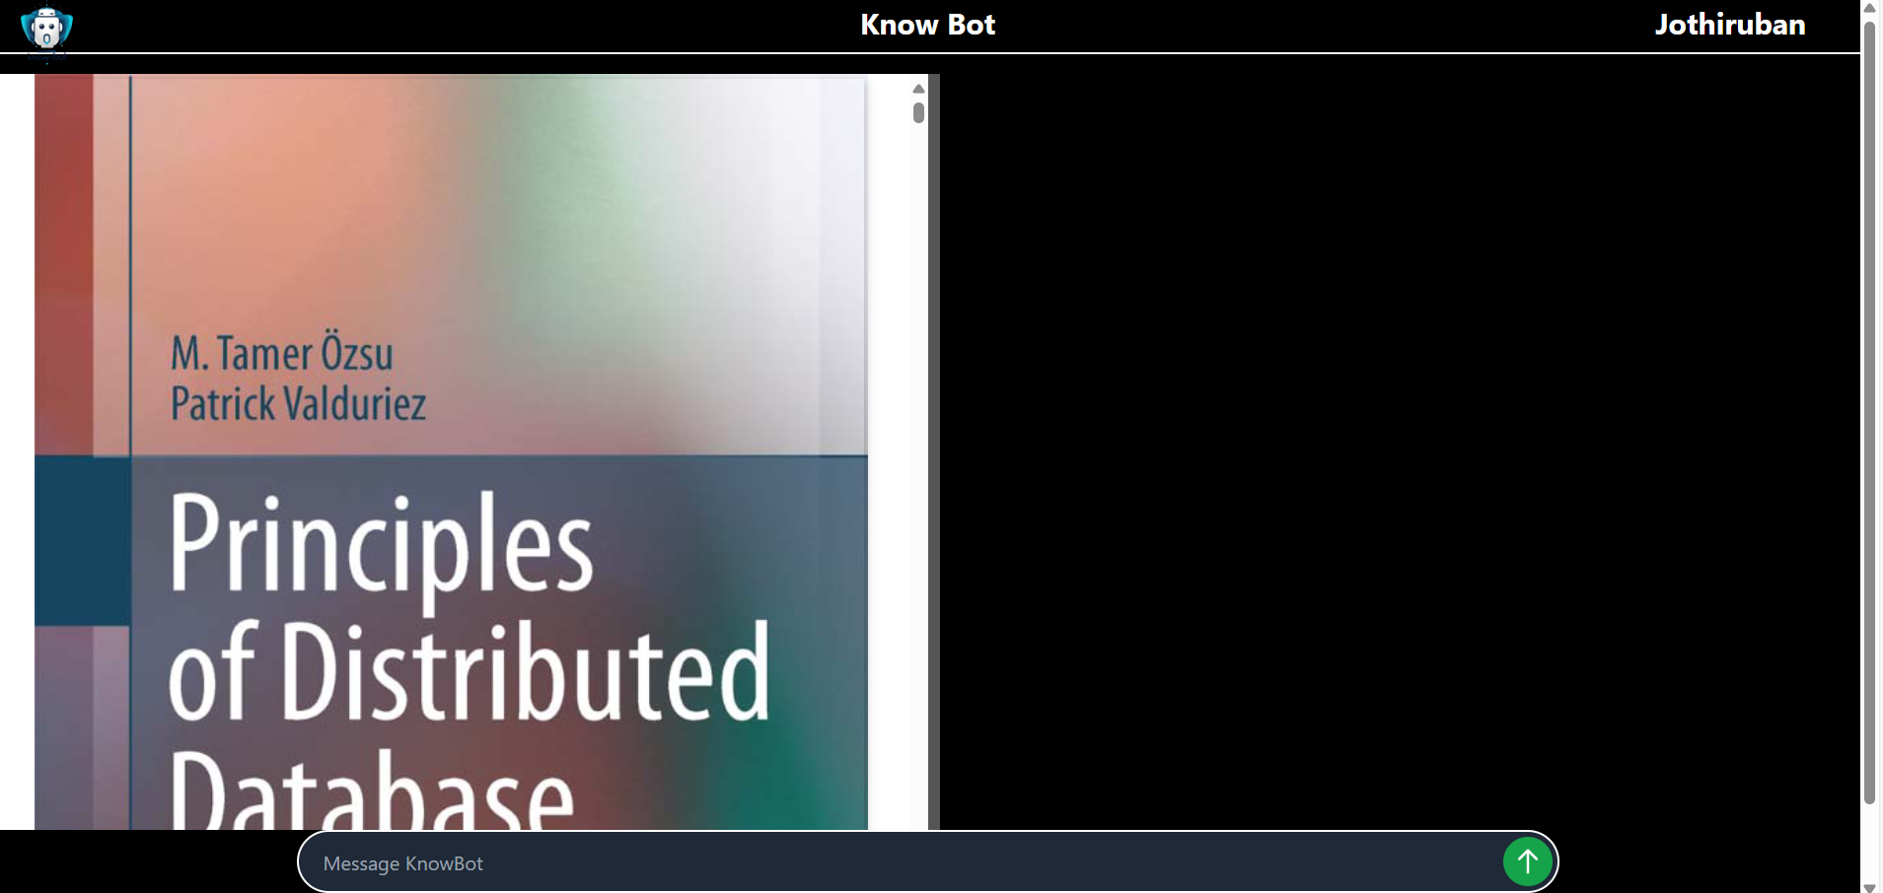
OUTPUT IMAGES

Slide 16
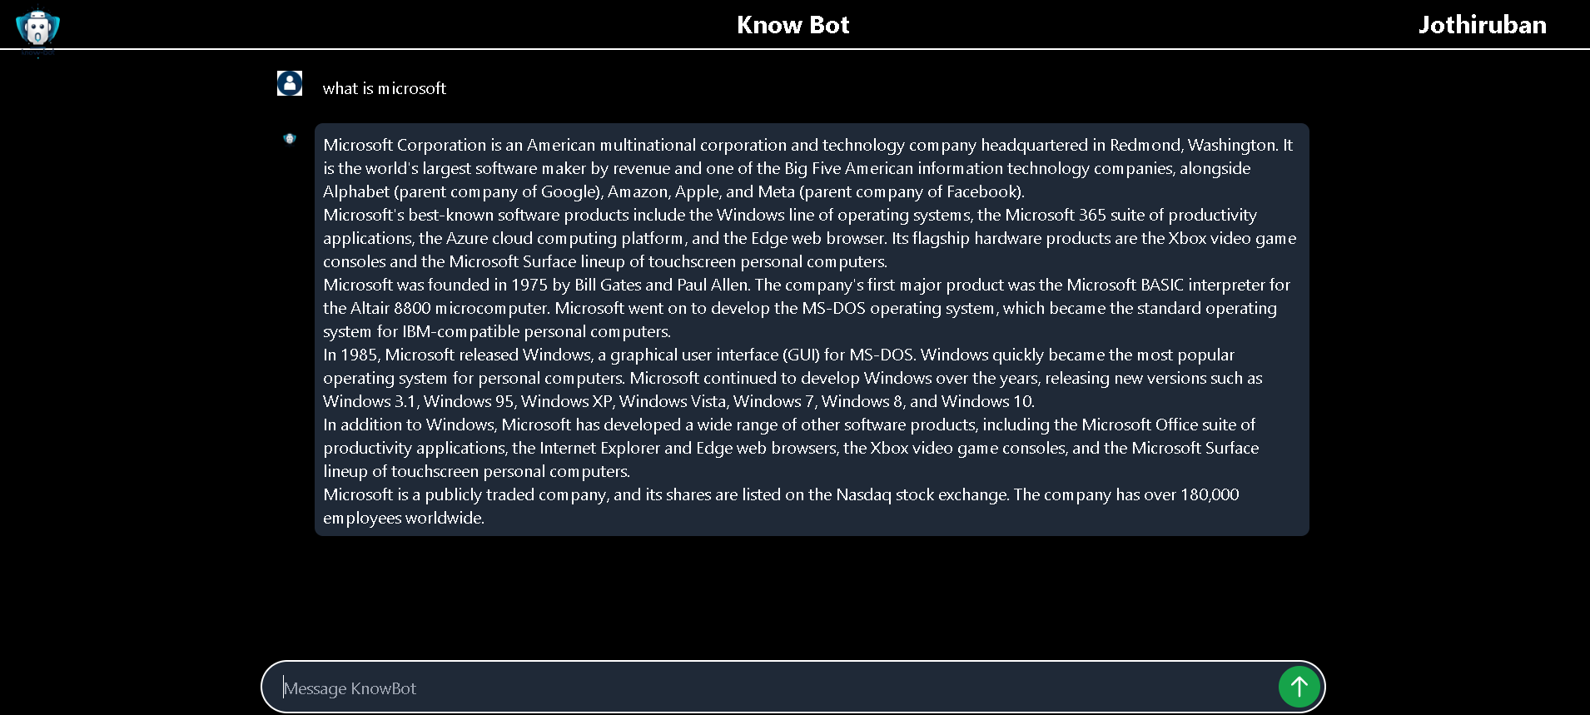
OUTPUT IMAGES

Slide 17
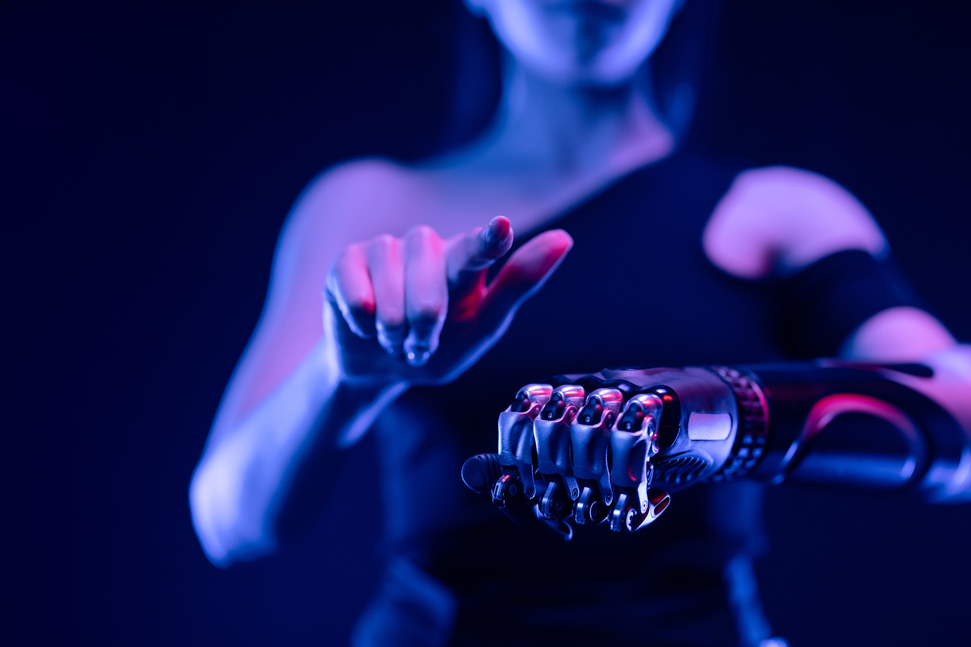
RESULT AND DISCUSSIONS
KnowBot ensures that all students receive a quality education and develop expertise in their field of interest
Youtube summary using video-to-text transcription extraction improves the quality of youtube summary, when compared to using the youtube provided default transcription.
Groq API provides faster response with free of cost.
Youtube, PDF content extraction takes more time for larger size.
PyTessaract gives more accurate result, when compared to other OCR models.

Slide 18
REFERENCE
Data for India, Education levels in India : https://www.dataforindia.com/education-levels-in-india
Ramneet; Deepali Gupta; Mani Madhukar, Operational Challenges in Online Self-Learning Education Adoption: https://ieeexplore.ieee.org/document/9609447
Junping Zhou, Design of AI-based self-learning platform for college English listening: https://ieeexplore.ieee.org/document/9361038
LangChain : https://python.langchain.com/docs/introduction

Slide 19
THANK YOU!

